Slide 1
18.1 Artificial Intelligence
Show understanding of how graphs can be used to aid Artificial Intelligence (AI)
Show understanding of how artificial neural networks have helped with machine learning
Show understanding of Deep Learning, Machine Learning and Reinforcement Learning and the reasons for using these methods.
Show understanding of back propagation of errors and regression methods in machine learning
Purpose and structure of a graph
Use A* and Dijkstra’s algorithms to perform searches on a graph
Candidates will not be required to write algorithms to set up, access, or perform searches on graphs
Understand machine learning categories, including supervised learning, unsupervised learning

Slide 2
Today
Show understanding of how graphs can be used to aid Artificial Intelligence (AI)
6. Use A* and Dijkstra’s algorithms to perform searches on a graph
Understand: How AI and graphs are linked
Able: Draw graphs using A* and Dijkstra
Answer: What is the difference between A* and Dijkstra

Slide 3
Quick Review of Graphs
Lets do a very quick review of graphs

Slide 4
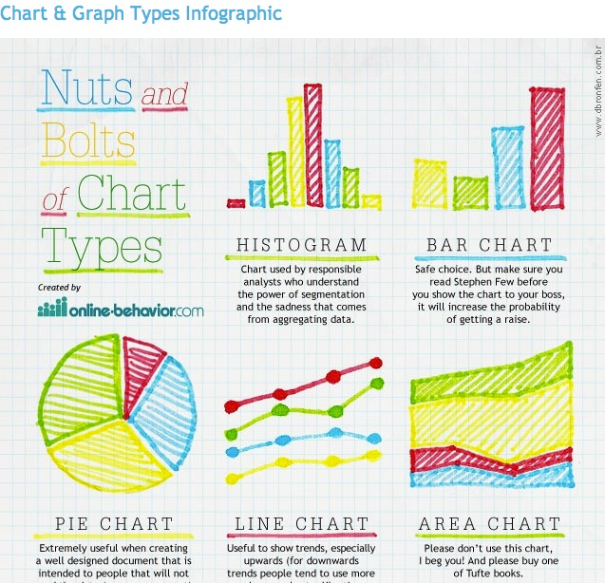
For Computer Science…..Is this a Graph?
NO

Slide 5
For Computer Science…..Is this a Graph?
NO

Slide 6
For Computer Science…..Is this a Graph?
NO

Slide 7
For Computer Science…..Is this a Graph?
YES
JUST JOKING. IT’S NO

Slide 8
For Computer Science…..Is this a Graph?
YES
Really, Yes

Slide 9
Graphs in Computer Science
It’s a data type.
But not like integer or string data type, Graphs are an Abstract Data Type (ADT)
And to even call it an ADT is a bit stupid because a graph doesn’t actually hold anything.
It’s just a way to show:
If there is a relationship between two things
Help you see the shortest path

Slide 10
Terminology
This graph shows 2 dots and a line
Nope.
Instead of dot we have to say vertex
Instead of line we have to say edge
And if you have more than one vertex then its called vertices
Annoying part….
Vertex / Vertices can also be called Points. Can also be called Nodes
Edge can also be called Arc. Can also be called Links. Can also be Paths. Can also be called Lines…… (but don’t say lines)
So this graph has:
2 vertices and one edge
Notes:
https://medium.com/@BennettGarner/what-the-graph-a-beginners-simple-intro-to-graphs-in-computer-science-3808d542a0e5
https://en.wikipedia.org/wiki/Graph_(abstract_data_type)
http://web.cecs.pdx.edu/~sheard/course/Cs163/Doc/Graphs.html

Slide 11
Different types of graphs
All graphs are made up of vertices / nodes and edges
But there are different types of graph
Undirected
Directed
Vertex labelled
Cyclic
Acyclic
Edge labelled
Weighted

Slide 12
Undirected
These just show the nodes and paths
No other information

Slide 13
Directed
Shows the order of the nodes
Shows the direction you must go
The paths have arrows

Slide 14
Vertex Labelled
A
B
Each vertex has a label.
Can be undirected or directed
Can be cyclic or acyclic (we will do this next)
Each vertex should have a unique label
C
A
B
C

Slide 15
Cyclic
A
B
If you can start from one node and follow your graph and return to the node you started with. It’s a cyclic graph
It has a loop
Not everything in the graph as to be in the loop, as long as there is a loop
Can be undirected or directed
C
D
A
B
C
D

Slide 16
Acyclic
A
B
There is no loop. Its not Cyclic
Can be undirected or directed. Usually directed.
Look at the directed graph. There is no loop
(The difference is this one, A goes to C, whereas in the previous cyclic graph C went to A)
C
D
A
B
C
D

Slide 17
Edge labelled
If vertex labelled put labels on the vertices, edge labelled puts labels on the edges.
Can be vertex labelled or not vertex labelled
Can be undirected or directional
Can be cyclic or acyclic
Each edge label should be unique
Edge1
Edge2
Edge3
A
Edge1
B
Edge2
Edge4
C
D
Edge3

Slide 18
Weighted Graph
Same as edge labelled.
But the edge labels are not just random labels but a number.
This numbers can be used to perform some arithmetic operation
So if we start at A and want to go to D
We can go direct A > D with a cost of 84
Or go A > B > C > D with a cost of 13
(5 + 6 + 2)
The weighted labels can be the same
84
A
5
B
6
2
C
D
2

Slide 19
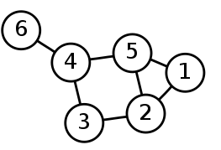
How to write graphs
So you can draw graphs with dots and lines, vertices and edges.
But how can you write graphs
You write them as sets within brackets:
Vertices sets lists all your vertices
Edge sets lists all the links between vertices
Vertices set:
{1, 2, 3, 4, 5, 6}
Edge set:
{(6,4), (4,5), (4,3), (5,2), (5,1) (3,2), (2,1)}

Slide 20
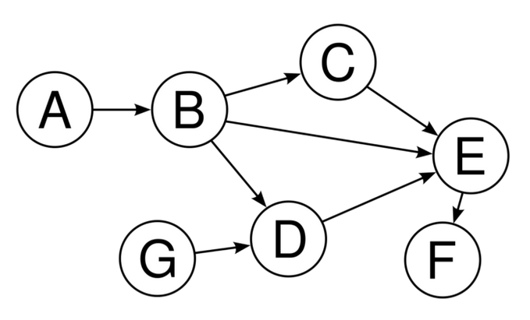
Task
Q1. Is this graph edge labelled?
Q2. Is this graph arc labelled?
Q3. Is this graph node labelled?
Q4. Is it cyclic?
Q5. Is it directional?
Q6. What is the vertices set?
Q7. What is the edge set?
A1. No
A2. No
A3. Yes
A4. No
A5. Yes
A6. {A,B,C,D,E,F}
A7. {(A,B), (B,C), (B,D), (B,E), (C,E), (D,E), (E,F), (G,D)}

Slide 21
Another way to write graphs
So one way is this:
Vertices set: {1, 2, 3, 4, 5, 6}
Edge set: {(6,4), (4,5), (4,3), (5,2), (5,1) (3,2), (2,1)}
Another way is:
graph1:: Graph Int graph1 6 = [4] graph1 5 = [1,2,4] graph1 4 = [3,5,6] graph1 3 = [4,2] graph1 2 = [1,3,5] graph1 1 = [2,5] graph1 _ = [ ]
But that still only says the vertices labels, so there is another way to include the edges

Slide 22
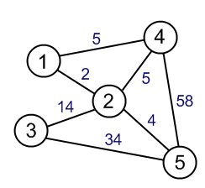
One more way to write graphs
graph6:: ELgraph Int Int
graph6 1 = [(4,5),(2,2)]
graph6 2 = [(1,2),(4,5),(3,14),(5,4)]
graph6 3 = [(2,14),(5,34)]
graph6 4 = [(1,5),(2,5),(5,58)]
graph6 5 = [(2,4),(3,34),(4,58)]
graph6 _ = []

Slide 23
Dijkstra Algorithm
Dijkstra (Dyke – Strah) is an algorithm to find the shortest path on a graph
Features
It uses a starting value. It uses a final value. It uses a temporary value, these are called working values. You have to order what you label
Rules:
1. The starting vertex / node should have a FINAL value of 0
2. Everything connecting to the first node should be given a temporary value
3. If that connecting node already has a working value, then if your value is lower you can replace it
4. Make sure the smallest working value is used as the final value is given to all nodes
5. Traceback the route to find the shortest path
Simple Rules:
1. First node’s final value is 0
2. Order of labelling is 1 because it’s the first final value you gave
3. The nodes connecting to the first node are given a working value The formula is: original node final value + distance
4. Find the next smallest working value
Repeat steps 3 and 4
5. Move backwards to find the shortest route

Slide 24
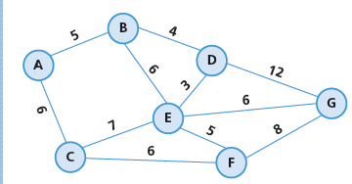
Dijkstra Example
Copy down this graph for your reference
To use Dijkstra, we have to redraw the graph

Slide 25
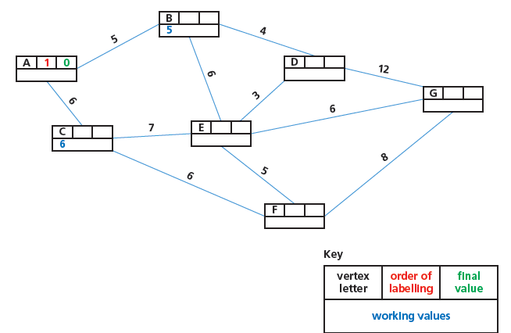
Dijkstra Example
So our first node ”A” is given a final value of 0 (green)
It was the first thing we labelled, so the order of labelling is 1 (red)
The nodes that connect to “A” are given working values. “B” is given the working value of 5 (blue)
“C” is given the working value of 6 (blue)

Slide 26
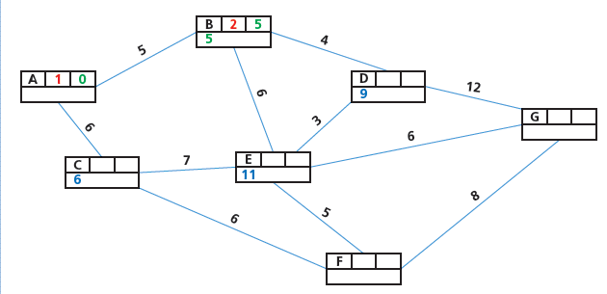
Dijkstra Example
The smallest working value right now is B with 5.
So now we make B’s final value 5 (green)
It’s the second thing we labelled so we make that 2 (red)
Now we look at what connects to B. D and E
The working values for D and E is calculated by:
B final value + Distance value
So for D its 5 +4
For E its 5 + 6

Slide 27
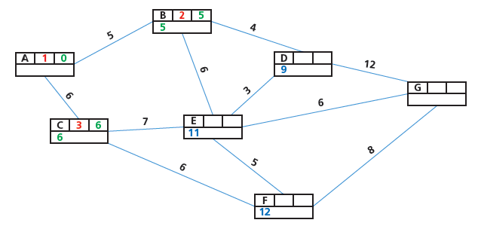
Dijkstra Example
Now look at this graph, what is our smallest working value?
Its C with a working value of 6
So now C’s final value becomes 6 (green)
It’s the third thing we labelled so its 3 (red)
We then find the working values for the nodes connecting to C (node E and F)

Slide 28
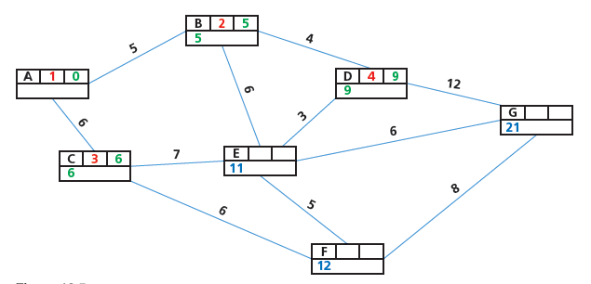
Dijkstra Example
Now D has are smallest working value with 9
Then 9 becomes its final value (green)
It’s the third fourth thing we labelled so it becomes 4 (red)
Then we check what nodes connect to D

Slide 29
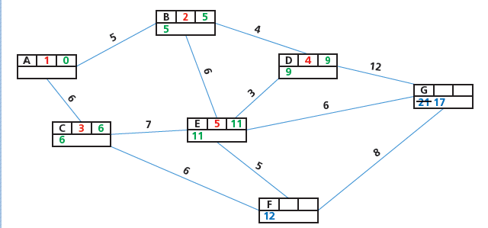
Dijkstra Example
Now E is smallest working value.
So we do the same thing.
Notice that G started with 21 but now will take a lower working value of 17

Slide 30
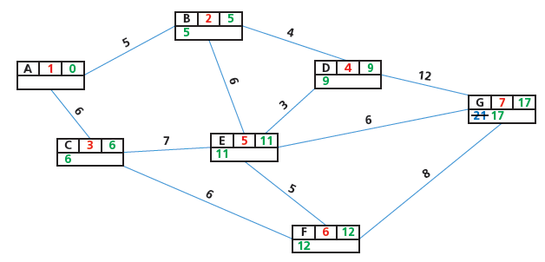
Dijkstra Example
Keep going until every node / vertex has a final value

Slide 31
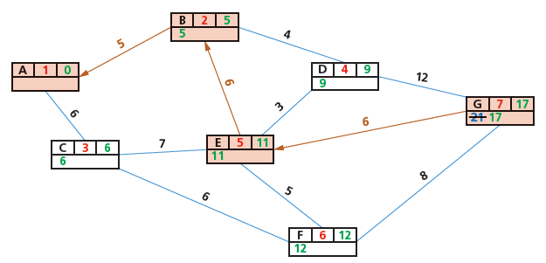
Dijkstra Example
Traceback from G to A to find the difference between the final values to find the shortest route

Slide 32
Dijkstra Example
Why is A >B > E > G the shortest?
G connects to D and E
G to D difference is 12
G to E difference is 6
So we use G and E
Then we just keep going

Slide 33
A* algorithm
Dijkstra shows you the shortest paths but it doesn’t care about direction. So it could take you away from your destination.
This can become a problem if you have complex problems.
So then A* algorithm was made.
A* is a heuristic algorithm
Heuristic = finds a practical solution instead of a theoretical one

Slide 34
A* Rules
With A* we care about 4 things:
1. The heuristic value (h) this is the distance from the end node
2. The movement cost (g)
3. The final cost (f) heuristic value (h) + the movement cost (g) = (f)
4. The previous node (n)

Slide 35
A* Example
Lets have a grid, we want to get from A to Z
A
Z

Slide 36
A* Example
The first we need to do is work out the heuristic value. The distance from Z. How many squares from A to Z. We have a few ways to route this.
A
Z

Slide 37
h cost
Our shortest heuristic value was with the pink path of 5.
For the heuristic value, include your final square
A
Z

Slide 38
h cost
So then we can write 5 as our heuristic (h) value for A
We have to do this for every node
A
A
H
5
Z

Slide 39
h cost
So then we can write 5 as our heuristic (h) value for A
We have to do this for every node
A
H
4
H
3
H
2
H
2
H
2
A
H
5
H
5
H
4
H
3
H
2
H
1
H
1
H
2
H
1
Z
H
5
H
4
H
3
H
0

Slide 40
g cost – Movement cost
But that’s not all we must do, now we must find the movement cost (g)
A
H
4
H
3
H
2
H
2
H
2
A
H
5
H
5
H
4
H
3
H
2
H
1
H
1
H
2
H
1
Z
H
5
H
4
H
3
H
0

Slide 41
g cost – Movement cost
If you start at any square, you can move to a possible 8 other squares.
In this example we start at ☺ and we can move to any of the 8 squares around ☺
But moving to these locations has a cost attached to it.
If you just moving up or down, or just left or right the cost is 1
If you move diagonally the cost is 1.4
Why 1.4?
Because diagonally really means you moving one square to the side and one square up or down. So it’s the square root of 2 squares which is 1.4.
But…. We don’t say 1 or 1.4, we then multiply it by 10.
So the g cost for going:
Up or down = 10
Left or right = 10
Diagonally - 14
☺

Slide 42
f cost = g cost + h cos
So we know the h cost and we can know the g cost from A. When you add these two numbers it becomes the f cost. Lets start at A and work out our f cost
A
14
H
2
H
2
H
2
A
5
G
10
H
4
H
3
G
0
H
5
18
H
2
H
1
H
1
15
G
14
H
4
H
3
G
10
H
5
H
2
H
1
Z
H
5
H
4
H
3
H
0

Slide 43
g cost + h cost = f cost
Now we go to the next smallest number, 14 and work out the F cost from there.
The g cost is always from the starting point A
A
14
H
2
H
2
H
2
G
10
H
4
23
A
5
G
20
H
3
G
0
H
5
18
H
2
H
1
H
1
G
14
H
4
27
15
G
24
H
3
G
10
H
5
H
2
H
1
Z
H
5
H
4
H
3
H
0

Slide 44
What if there are many g costs?
For the red square (I just made it red for this example) it has a f cost of 27.
The h cost is 3, but why is the G cost 24?
Well it actually had different g costs.
Remember to workout the g cost, include the square you on as it’s the distance from A
The first G cost goes up and left (square 23 then square 14 then square A), this is a cost of 30
The next g cost could be go left, left, up (18, 15, A) cost of 30
Another g cost could be left and diagonal up (18, A) cost of 24
Another g cost could be diagonal up then left (14, A) cost of 24
So just pick the smallest one. If you have two that are the same, pick the one with the smaller h cost
A
14
H
2
H
2
H
2
G
10
H
4
23
A
5
G
20
H
3
G
0
H
5
18
H
2
H
1
H
1
G
14
H
4
27
15
G
24
H
3
G
10
H
5
H
2
H
1
Z
H
5
H
4
H
3
H
0

Slide 45
Video
You keep calculating going through the grid.
You final path is by working out the shortest f numbers.
The next video shows this
But, we did our h costs based on how many squares. So if we was 3 squares away, then we would write 3.
In the video he used a method of if he was 3 squares away, but it was up, left and diagonal, his cost was 38 (10 + 10 + 14)
It’s a long video (12 minutes) we only need the first part of it and we don’t need the arrows or the pseudocode (his pseudocode is not the same as Cambridge pseudocode)

Slide 46
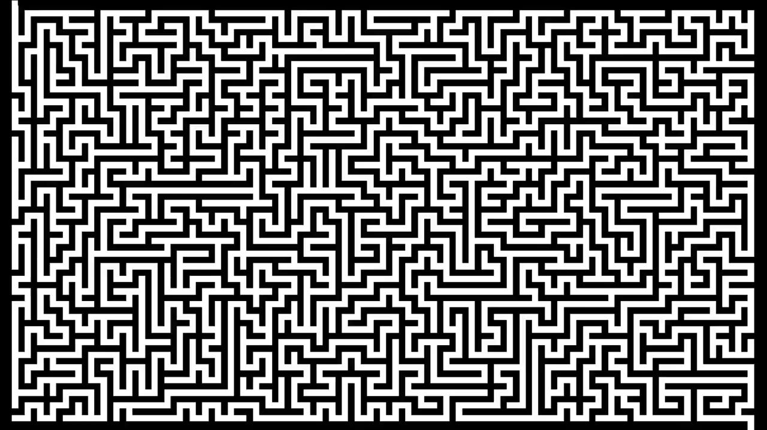
Video

Slide 47
So what?
So what? Where do we use Dijkstra and A*??
We use them for path finding and finding the shortest paths.
In graphs
Network topologies
GPS global positioning satellites
Google / Baidu / Didi Maps
Model the spread of infectious diseases
In fact that square layout we did with A* is called a Manhattan layout as it was used to work out the fastest routes across Manhattan in New York

Slide 48
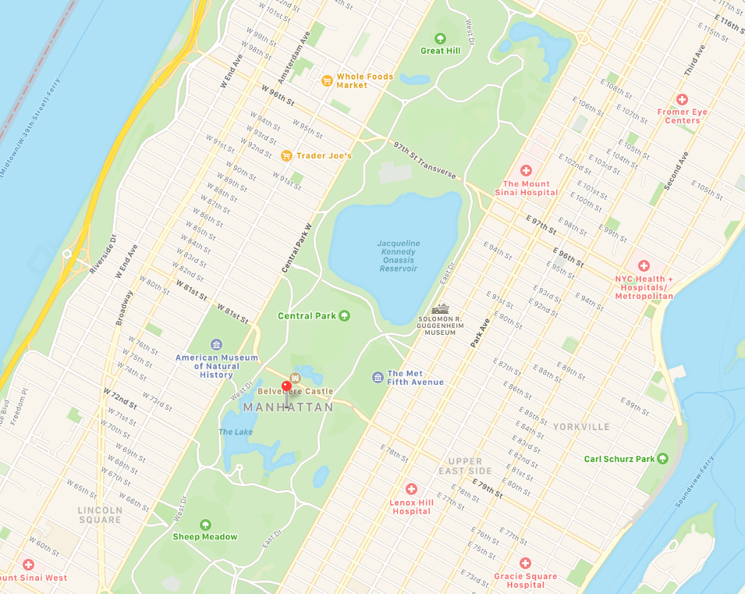
Manhattan
Why Manhattan?
Because the streets are in a grid layout

Slide 49
Today
2. Show understanding of how artificial neural networks have helped with machine learning
3. Show understanding of Deep Learning, Machine Learning and Reinforcement Learning and the reasons for using these methods.
4. Show understanding of back propagation of errors and regression methods in machine learning
Understand: What is Machine Learning
Able: Describe the difference between Machine Learning and AI
Answer: What is back propagation?

Slide 50
AI vs ML vs DL
Three terms:
1. Artificial Intelligence (AI)
2. Machine Learning (ML)
3. Deep Learning (DL)
Which of these statements describes AI, ML and DL
If you, a human, program a machine to think like a human
The machine can learn new things without it being programmed to specifically learn these new things, it learns by itself.
Uses a neural network to think and behave like a human.

Slide 51
ANSWERS
1. Artificial Intelligence (AI)
2. Machine Learning (ML)
3. Deep Learning (DL)
Which of these statements describes AI, ML and DL
AI = If you, a human, program a machine to think like a human
ML = The machine can learn new things without it being programmed to specifically learn these new things, it learns by itself.
DL = Uses a neural network to think and behave like a human.

Slide 52
Is everything AI?
But wait, if we say that ML means a computer can learn by itself, doesn’t a human have to initially tell the computer that it CAN learn by itself, doesn’t a human have to make a first program to tell the computer HOW to learn and then the computer can learn by itself.
Yes, a human first needs to make a learning program.
So if a human needs to make a program first, isn’t Machine Learning just part of AI?
Yes it is. But we don’t say “part of” we say subset.
AI can include everything and part of it is ML and part of ML is DL or is we say it correctly:
DL is a subset of ML, ML is a subset of AI
AI
ML
DL

Slide 53
Types of AI
So if ML and DL are a subset of AI, it means everything is AI right?? Yep. This is correct.
But we split it up into ML and DL as these are more advanced versions.
There are 3 versions that AI and subsets of AI can fall into:
Narrow AI
General AI
Strong AI

Slide 54
Narrow, General, Strong
Narrow AI = When a machine is better than a human in one task
General AI = When a machine is similar to a human in many tasks
Strong AI = When a machine is better than a human in many tasks

Slide 55
Machine Learning
Machine learning is when a machine can learn from past experiences.
But this is a lie
What Machine learning actually does is build a profile and then guesses
It should really be called Machine Guessing, but Machine Learning sounds more advanced.

Slide 56

Real Example
This is my music player app on my phone. (Amazon Music)
It uses Machine Learning to know what songs to play.
When I like a song, I press the thumbs-up button
When I hate a song, I press the thumbs-down button

Slide 57
Profile
Most of the time I listen to music when I am in the gym.
So the app builds a profile of me of songs I tend to like
Most of the time I like fast songs with a female singer
Fast
Slow
Male
Female

Slide 58




Past Experiences
So the machine now knows that I prefer fast songs with a female singer, so it plays me songs that fit into this category. It doesn’t know if I like them, but it guesses that I will like them based from my past experience
But sometimes it will play Linkin Park, which I also like, but it has a male singer, so how does it know to play Linkin Park?

Slide 59
Lie
I lied, I said it plays songs “based from my past experience” but this is a lie, because its not just MY experiences but from everyone else who uses the app.
It knows I like Avril Lavigne, and then it looks at all the other people who like Avril Lavigne. Out of all of those people, 80% of them also liked Linkin Park, so the machines GUESSES that I would also like Linkin Park.
But the guess is not random, its based on the past inputs of everyone who used the app. The more data it has the better the guess it provides

Slide 60
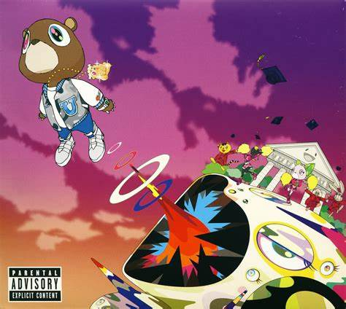
Problem
A problem with this method is I also like Kanye West. But this is slower songs with a male voice.
But using my profile, Machine Learning is unlikely to pick this.
So you have to search for it manually, press “thumbs-up” and then allow ML to adjust your profile

Slide 61

New Song
Here is a new song. “Stadium Arcadium”
How does the machine know if I would like it?
Well someone has to tell the machine some data about the song.
Who is the artist?
How long is the song?
What genre is the song?
What is the tempo of the song?
Male or female singer?
(and lots more data needs to be entered)
Once the song has been given all this data then the machine knows if it should recommend it to me.
Because this song has now been given data, we call it labelled data.

Slide 62
Labelled vs Unlabelled
Labelled data = When information about your data has been filled in
Unlabelled data = When your data has no information stored about it.
Does this mean that if I have unlabelled data, that for Machine Learning to work, a person has to sit there and type in information about my data to make it labelled data?
This seems like a slow and stupid process
It is.
What is better is if we can make the machine take unlabelled data and have the machine turn it into labelled data for us.

Slide 63
Unlabelled to Labelled Data
So how can a machine turn unlabelled data into labelled data?
There are 4 ways a machine can learn from the labelled and unlabelled data.
Supervised
Unsupervised
Semi-Supervised
Reinforcement

Slide 64

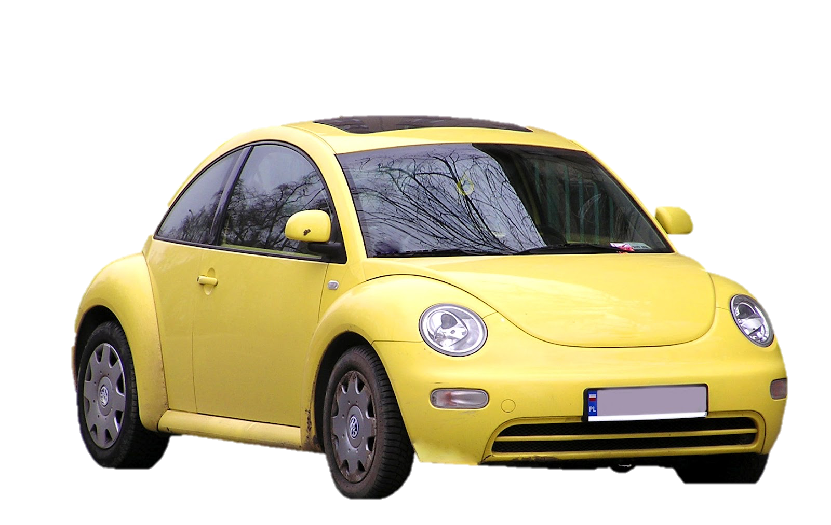
Supervised Learning
1. A human has to label some initial data
2. The human gives this to the machine
3. The machine then analyses this data
4. The machine gives an output
5. The output is checked to see if its correct
6. The machine then is given some unlabelled data to see if it can still be accurate.
Human to machine : This is a fish
Human to machine: Machine, what is this?
Machine to human: It’s a fish
Human to machine: What is this?
Machine to human: It’s a fish

Slide 65

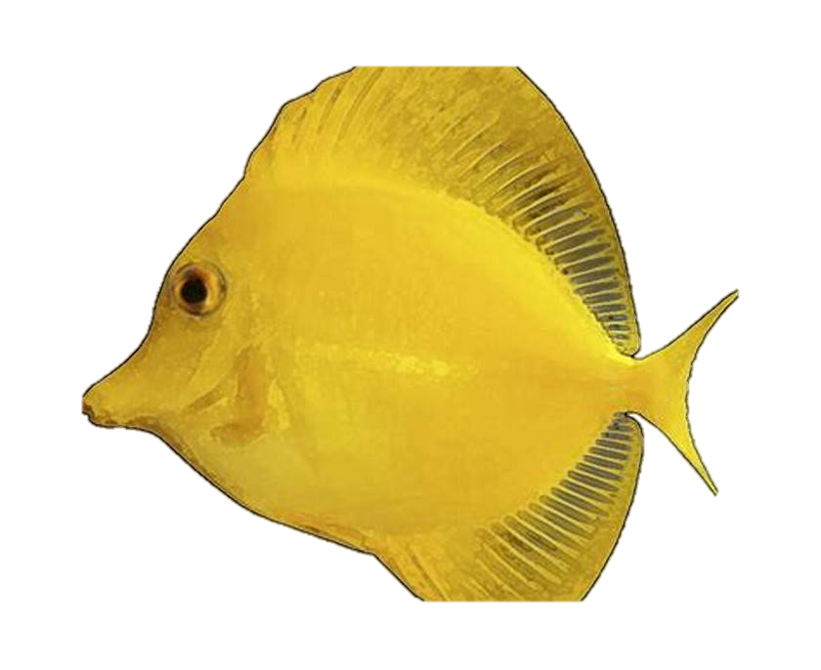

Unlabelled to Labelled Data – Initial Data Set
Someone has to tell the machine that these are all fish, and tell the machine what makes them fish. This initial data must be labelled.

Slide 66

Supervised learning
Once the first labelled data set has been inputted, when the machine then gets a new piece of unlabelled data it will guess based on the information it has if it’s a fish or not.
So if we give it the new unlabelled image(the bird), then it will look at it, analyse what it knows about fishes and then decide if it’s a fish or not.
In this example its hard, because our original data set is only 4 fish and we have no data about birds. But if we had 5000 fish and 5000 birds already labelled then the machine can better guess about our new image.

Slide 67
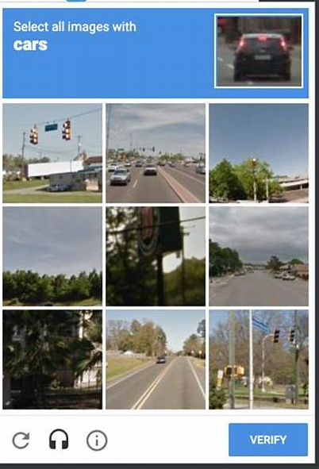
Still stupid and slow
So, you still need a person to first say what is a fish is.
Yep.
And you need to have many fishes so the machine can ‘learn’ better
Yep.
It’s still slow and stupid
Yep
But you have all helped to label data

Slide 68
Supervised learning
If your initial data set is large, then you can get accurate results
Used if you need to put something into categories / you need to classify the data
Used for regression modelling.
Regression modelling = When you use different data items to find a result. This answer will usually be a number
+ Accurate results
+ The output given can help the machine next time to learn better
+ Less computing time
+ Simple
More human time needed
Needs labelled data

Slide 69
Regression
Regression modelling = When you use different data items to find a result. This answer will usually be a number
Example: You want to know how much money you should have as you grow older
So you input data of how much money people had at different ages in their life
Supervised Machine Learning takes this information,
Analyses it, and can say roughly what the expected outcome should be for you.
In real life its used for
profit/loss for companies
how much a company can charge for products
How long it takes to drive home under different weather conditions
Rich
Poor
Young
Old

Slide 70
Unsupervised
If supervised needed labelled data, what do you think unsupervised uses?
It uses unlabelled data
It looks at your unlabelled data and looks for patterns among the data and can group together data / cluster the data.
Or it can do association
Unsupervised machine learning cannot give you precise answers but it looks for patterns.

Slide 71
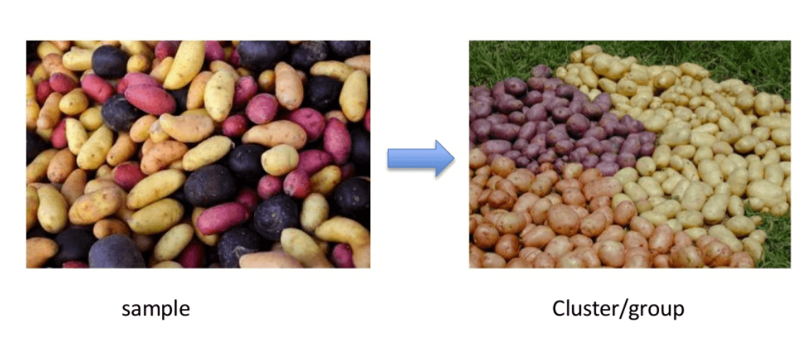
Unsupervised. Cluster and Association
Cluster is a fancy word for grouping
Take your unlabelled data
Machine analyses this data
Puts them in different groups / clusters
Association
Takes your data
Takes some other data
Looks for relationships between them
Example: If you have this gene then you will get Cancer

Slide 72
Unsupervised
+ Uses unlabelled data, so less human time needed
Not precise or accurate
Takes more computational time to complete
It just outputs the data, it does NOT learn from the output to improve next time

Slide 73
Semi-Supervised
When you some labelled AND unlabelled data.
Usually a small amount of labelled data and a LARGE amount of unlabelled data.
That way you can get better accuracy than unsupervised but don’t need to waste a lot of time getting a lot of labelled data like you need to do for supervised.
Example: Website groups.
If you wanted to list all the sport websites, all the fashion websites, all the science websites, all the video websites…. You don’t want to manually label all of them, so label a few and then let the machine do the rest.

Slide 74
Semi - Supervised
+Small amount of labelled data needed
+ Less human cost then supervised
+ Better results then unsupervised
-More complicated to compute then supervised
-Not as good results as supervised

Slide 75
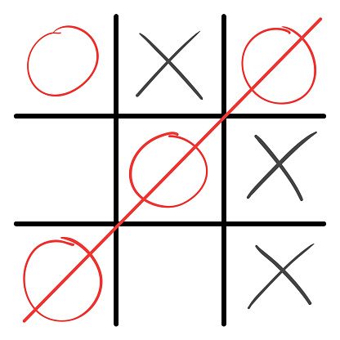
Reinforcement
This is where you tell machine what to do.
The machine does it.
Each time the machine does it, they see if it was done correctly or not.
Games: Chess, Tic Tac Toe…..
Robots: Maids, bartenders, Androids
There are two types of reinforcement
Positive reinforcement
Negative reinforcement

Slide 76
Positive and Negative
Positive reinforcement = If the machine did something and the result was positive. The output was faster, higher, better.
Negative reinforcement = If the output was stopped or too slow.
Its not the same as human positive reinforcement and negative reinforcement. Its not if the machine did something good or bad, but if the output of the machine is positive or negative
We’ve used the word ”output” but reinforcement machine learning uses other words:
Agent = The machine
Action = What the machine does
Environment = Where the machine operates
State = What is the situation in the environment
Effect = What the machine did

Slide 77
Reinforcement
+ Doesn’t need labelled or unlabelled data
+ Perform a task
+ Actually learn
Can be a slow process
May need many repetitions before doing something correct
Can kill all humans

Slide 78

iRobot
There’s a movie, iRobot.
They have these robot helpers that can help clean, serve you, just do normal daily things.
Every robot has these 3 laws.
Law 1: A robot may not injure a human being or through inaction allow a human being to come to harm
Law 2: A robot must obey orders given it by a human being except where such orders would conflict with first law
Law 3: A robot must protect its own existence as long as such protection does not conflict with the first or second law
In the movie the old robots are replaced by new robots with better AI. What do you think the problem with these laws would be?

Slide 79
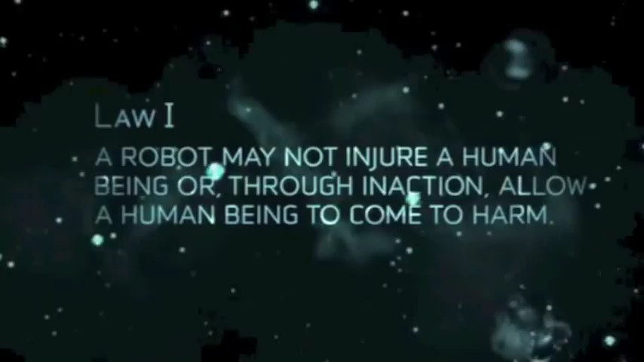

Slide 80
Humans are the robot’s slaves
Law 1: A robot may not injure a human being or through inaction allow a human being to come to harm
Law 2: A robot must obey orders given it by a human being except where such orders would conflict with first law
Law 3: A robot must protect its own existence as long as such protection does not conflict with the first or second law
The robots decided that because humans are still killing other humans (war, lack of resources / food etc…) that its better to control and keep all humans prisoners so they cannot kill other humans.
The laws are in tact. The logic is correct.

Slide 81
Deep Learning
So if Machine Learning is a part of AI.
Deep Learning is a part of Machine Learning, which is part of AI.
Deep Learning is a more advanced version of Machine Learning.
It uses at least 3 different layers
Input Layer
At least one hidden layer
Output layer
These layers combined are called a Artificial Neural Network

Slide 82
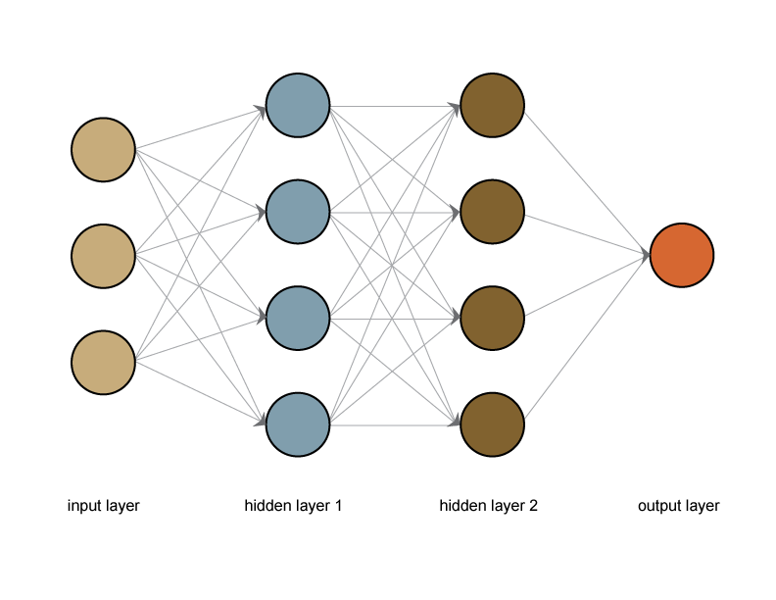
Before we go deep into deep learning
I’m going to do what Cambridge wants, but what they want is a little simple, so then we will do a more advanced explanation just so we understand it better.
So we said that DL uses at least 3 layers, input, hidden and output.
Here we have 2 hidden layers

Slide 83
Layers
In this example, our input layer has three elements,
Hidden layer 1 has four elements
Hidden layer 2 has four elements
Output layer has one element
But we don’t say element, we say neuron
Input layer has three neurons
Hidden layer 1 has four neurons
Hidden layer 2 has four neurons
Output layer has four neurons

Slide 84
How many layers and how many neurons
The number of neurons you have and the number of hidden layers you have are up to you.
The way that neural networks work, is that the what happens in one layer affects the next layer which affects the next and the next… until you get an output.
You may not get one single output, you may get multiple outputs
The next page shows this

Slide 85
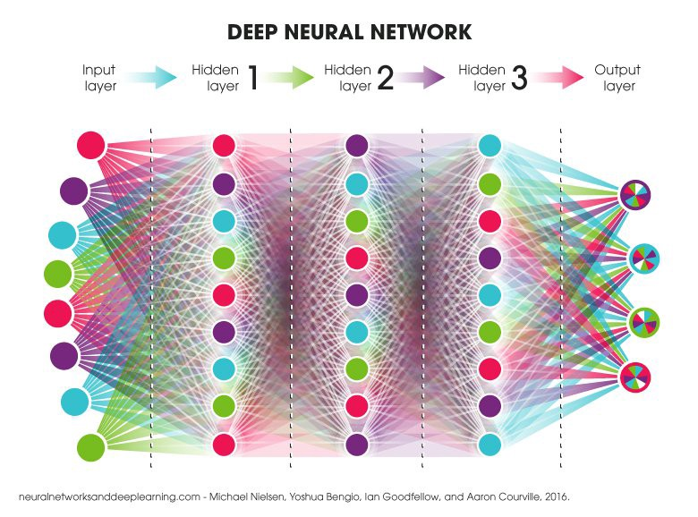
Simple network
Deeper network

Slide 86
Neuron
Okay so we have a number of layers and we have a bunch of neurons.
But WTF is a neuron?
In a human a neuron is something can get an electrical signal and deliver it via synapses to another neuron.
In Deep Learning, a neuron is just something that holds a number

Slide 87
Input layer
Okay, I understand how the output layer may have more than one answer, so it needs more than one neuron, but what about the input layer? Why does this have more than one neuron. Surely I just input one thing right?
Yep, you do. Its just that the input has a stupid name. Its not really the input layer, it the “features of the input” layer

Slide 88
Square
Let’s use this square as our input
Our input layer neurons recognise what are the features of the square

Slide 89

Our input layer sees the features of this square
The input layer looks at each pixel of the image.
Lets say it looks at the top left pixel of our square image.
It then tries to recognise this pattern
It fires off the relevant neuron that matches the pattern.

Slide 90
Hidden layers
Then our hidden layers look for patterns that connect to our input layer neuron.
Then it links to the next hidden layer, and so on and so on until an output is given
Because this method looks at how many pixels are in an area, its called a pixel density method
(I did not draw the lines, because then it becomes so disgusting to look at)

Slide 91
Told you….
Told you…. That’s all Cambridge want you to know… actually even that is a bit MORE then Cambridge wants you to know.
But it doesn’t happen by magic. So we will watch something that explains it.
But, before we do that, we need to find out where Deep Learning and Neutral Networks it use are used.

Slide 92
Uses
Recognise faces / people
Recognise objects
Photo enhancement
Chat-bots
Black & White into Colour
Text mining
Voice
Translation

Slide 93
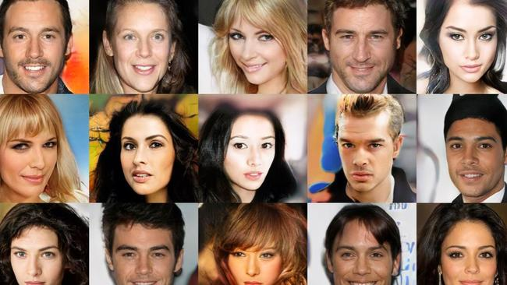
Recognise
Recognise faces / people
Recognise objects / animals
Uses the same pixel density method

Slide 94
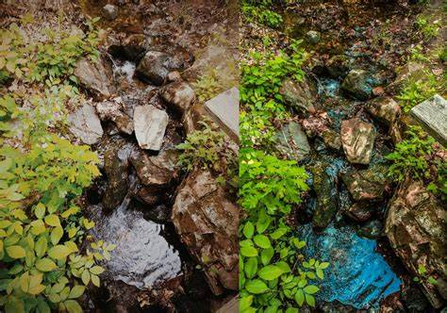
Photo Enhancement
Your phone now uses deep learning to improve its photos.
Photos of the same object were taken using a DSLR camera and the same photo using your phone.
Then the features of the DSLR photos was compared against your phone’s photo and the output is a picture taken with your phone that used deep learning to get a better photo

Slide 95

Chat Bot
Used for customer service
Tries to replicate human conversation
Usually not very good but MUCH MUCH better then before.

Slide 96
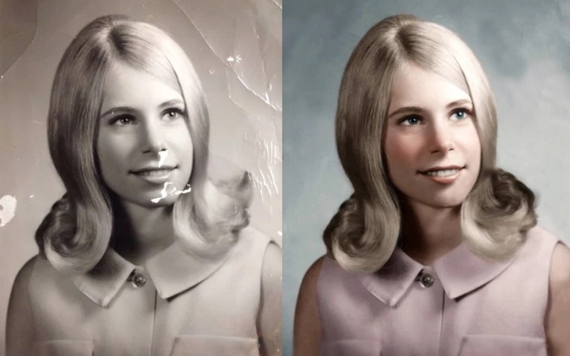

Black and white into colour
The deep learning system looks at the features of your black and white (monochrome) image.
Compares it to features it already has learnt in the past
Then outputs a colour image based on its thoughts

Slide 97
Text mining
Could a deep learning system understand what the letter “A” looks like?
Yep
What about all the other letters, can it understand those?
Yep
Well just add letter after letter to understand words
So if your system can understand the letters “A” “C” and “T” then it can read the word “CAT”
So if you have 10000000 books and you want to order them into different categories (romance, horror, educational, nature, cooking etc…) then your deep learning system can read the books and use its neural network to put the book in the correct category.
The words it uses to get an output are called Tags

Slide 98
Voice
Same as text translation but instead of looking at letters and words, it analyses the voice patterns of speech

Slide 99
Translation
This is also called CAT
Computer Aided Translation
Two formats of CAT but they can be used together
Terminology Database
Translation Memory
Terminology Database just use a translation dictionary AND now uses human corrections to help make a new database of better translations.
Translation memory mean that known, or common sentences or phrases have a fixed translation.
So 你好 does not mean ”you good” it becomes “hello”

Slide 100
Labelled or unlabelled?
Does deep learning use labelled data or unlabelled data?
Usually you give the input layer (which really should be called ’features of the input layer’) unlabelled data.
But then if you give unlabelled data how does the network know what to compare it against and how to make sure your output is correct?
When you first make the neural network you can give it some labelled data to check if the output is correct.
If the output is wrong, then you keep making changes to your network until the outputs are correct.
This is called back propagation.
You may need to do this many, many times before you are happy.

Slide 101
Back Propagation
You input something into the system
The output the system gives is compared to what the output should be
The differences are fed back into the system
Keep doing this until the outputs are correct (it could be the case that they are never 100% correct, but just good enough)
How does it compare the errors? By using the weightings given to each neuron

Slide 102
Video
I usually do the following for videos.
Give you questions to answer
Watch the video twice
But this is a 20 minute video and goes into more detail than we need. We’ve done everything that Cambridge wants.
So…..you have a slightly different task

Slide 103
Task
Each of you pick a number:
1 2 3 4 5 6 7 8 9 10 11 12 13 14 15 16 17 18 19 20
Now pick another number
1 2 3 4 5 6 7 8 9 10 11 12 13 14 15 16 17 18 19 20
You should now have two numbers. Yellow and Red.
The yellow number says how many questions (and answers) you must write. The red number says from the start of the video to your red number is where the content of your questions must come from So for example. If you picked 10 17 . It means you must write 10 questions (and answers) from minute 0 to 17 If you picked 20 1 then you must write 20 questions (and answers) from minute 0 to 1
You will write your questions then we will get other students to answer them, but you should have your own answer ready

Slide 104


